Slide 1


Fundamentals of RM
RM System and Process
Leadership in RM
Incident Investigation
RM Tools & Challenges
RM in Industry
People & Org.
Application and Perspectives
On Becoming a
Leader in Risk Management
ENGG404 - Lecture
Case 7: BP-Macondo
Oilfield and DeepWater Horizon Rig
(2010)

Slide 2
Learning Outcomes
Explain that management has the responsibility for sound risk management systems covering both occupational safety and process safety.
Demonstrate why leaders must smartly allocate finite resources to ensure high-hazard operations (i.e. with significant process safety hazards) are sustainably managed to acceptable risk exposure levels.
Evaluate a loss incident to identify the latent causes and associated management system improvement opportunities.
Case 7: BP-Macondo DWH 2010
2
Notes:
2

Slide 3
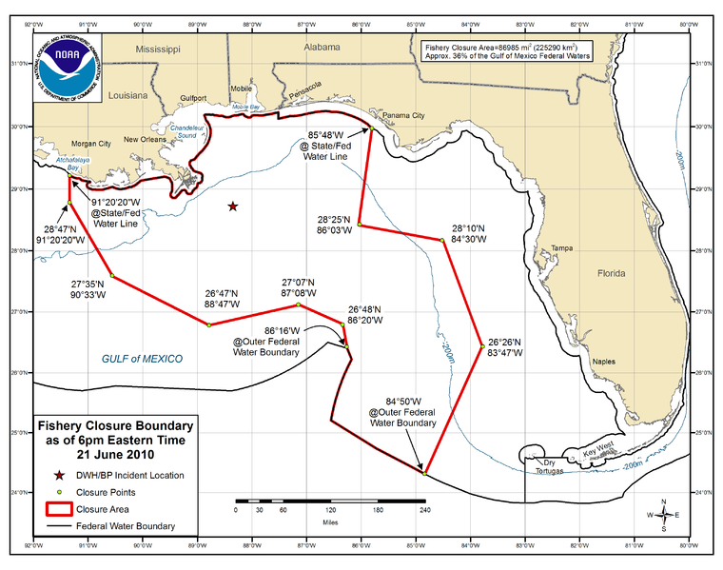
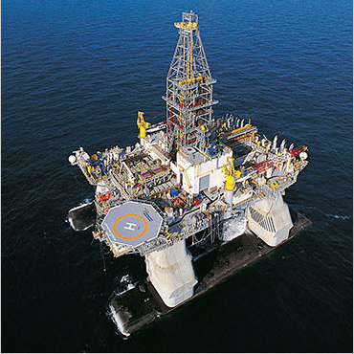
Background:
Deep Sub-sea Drilling – catastrophic event:
Low likelihood, extremely high consequence
Three major corporations:
BP Energy:
TransOcean:
Halliburton:
Case 7: BP-Macondo DWH 2010
3
Notes:
3

Slide 4
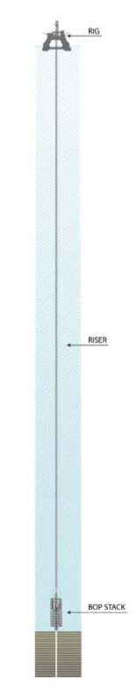
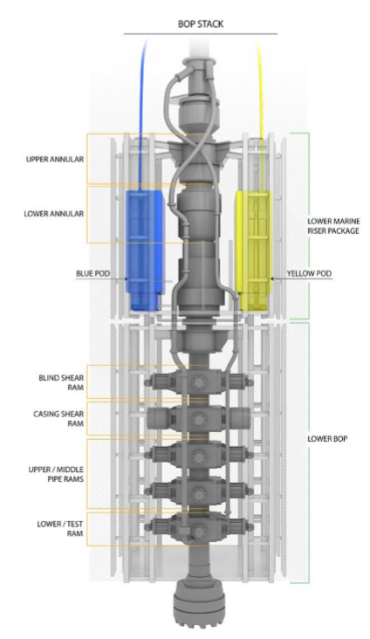
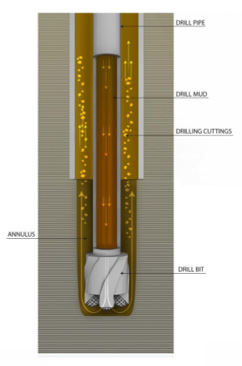
The Basics Of Well Control:
Surface to sea-floor BOP ~15 metres Drilling End ~ 3 metres
Case 7: BP-Macondo DWH 2010
4
Notes:
4
4
Much of this info is presented in the videos, so suggest that they listen for the details of the technology, especially for the engineers who do not study petroleum engineering. Briefly explain:
The distance between the rig and the sea-floor.
The depth beyond the sea-floor that the drill goes.
The purpose and basic design of drilling fluid (mud).
The basic theory of a “kick”.
The need to ensure that the drill bit speed does not exceed specified conditions (cracks the formation).
The purpose of cementing and location of plugs after drilling is complete and the well is being sealed in for future production.
The purpose of a BOP.

Slide 5
Background:
Deepest oil well in history - 35,000 ft (10,500 metres) – a Record!
Rush to get to production: 6 weeks normal vs 21 days target
Rig operated Seven (7) years without a Lost-Time Injury
  A great achievement!
The BOP had been damaged 4 weeks before the incident:
  “Wasn’t important”; wasn’t fixed; operations continued
Unclear chain of command for changes made to activities
  Who was in charge? BP or TransOcean?
Case 7: BP-Macondo DWH 2010
5
Notes:
5

Slide 6
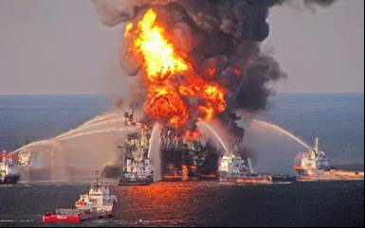
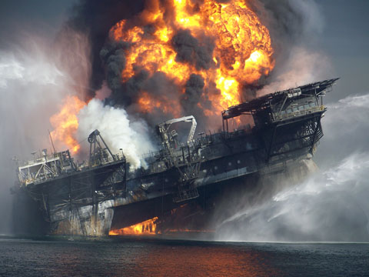
The Loss Incident & Impacts on PEAP
The Loss Incident:
Date: 20-April-2010 to 15-July-2010
Platform: Deepwater Horizon Drilling Rig
Location: The Macondo Prospect, Gulf of Mexico
Corporations: BP plc, TransOcean, Halliburton
Impact on PEAP:
P: 11 killed, 16 seriously injured
E: Inestimable impact
A: Tens of billions of dollars
P: Broad interruptions for US Gulf of Mexico offshore drilling industry; and Significant regulator intervention with regulatory impact
* Prolonged and extensive media coverage (reputational impact)
Case 7: BP-Macondo DWH 2010
6
Notes:
6
6
Much of this info is presented in the videos, so provide a very brief overview of the corporations involved and the Impacts on PEAP.

Slide 7
Documentary Videos – Viewed via eClass:
These Documentary Videos on the BP DWH Blowout, Gulf of Mexico, LA, are posted on eClass for viewing prior to the lecture.
US-CSB Video:
00:00-01:20 Introduction and CSB Investigation
01:21-02:35 Technical explanation – drilling, mud, kicks
02:36-03:38 BOP Operation
03:39-04:57 The Kick initiates the incident
04:58-05:24 Buckled Pipe and Effective Compression
CBS News 60 Minutes Video, Part 1:
02:03-03:04 Background
02:18-03:04 Technical explanation - rate of penetration
03:05-04:36 “Tension” – push to do things safely but fast (competing priorities)
CBS News 60 Minutes Video, Part 2:
02:40-7:15 Professor Bob Bea – discussion points akin to “The Engineer’s Survival Guide”
Case 7: BP-Macondo DWH 2010
7
Notes:
7

Slide 8
Incident Causes
Rush to “get the job done”:
  Drilling rate faster than specified for formation
  Cement barrier (plug) not effectively installed
  Premature removal of drilling fluid / mud before cement plugs were completed (cured)
Defective Blowout Preventer operation – a “safety-critical device”:
  Damaged Annular on the BOP
  Inoperative Control Pods on the BOP
  Damaged hydraulic line and weak battery on the BOP
Incorrect interpretation of well data:
  Inadequate standards or inadequate compliance with standards
  Process signals of a “kick” ignored (the lead-up prior to a blow-out)
  Cement integrity test did not give a clear “pass / fail” i.e. pressure test failed to confirm mud and plug integrity (pressure should have remained static / less mud returned to surface)
Case 7: BP-Macondo DWH 2010
8
Notes:
8

Slide 9
Incident Causes
Excerpt from The US-CSB Report:
“… no effective safeguards were in place to eliminate or minimize the consequences of a process safety incident.
The safeguards (the physical barriers such as drilling mud, steel casing, cement plugs, “kick” detection, cement barrier testing, and BOP) intended to prevent such a disaster were not properly constructed, tested, or maintained, or they had been removed.
The management systems intended to ensure functionality, availability, and reliability of these safety-critical safeguards were inadequate.
The safeguards meant to prevent, mitigate, or control a blowout failed on the day of the accident.
If the drilling column fluid (mud weight) barrier and the cement barrier both fail, and the well is still open (no plug installed), drilling crews depend on a blowout preventer (BOP) to control pore pressures.”
US Chemical Safety And Hazard Investigation Board;
Investigation Report, Volume 1; Explosion And Fire At
The Macondo Well; Report No. 2010-10-I-OS; 5-June-2014
* Layers of Protection
Three LoP* failed!
Case 7: BP-Macondo DWH 2010
9
Notes:
9

Slide 10
Immediate and Basic Causes … Latent Causes? Culture?
Continue to Drill Down in the RCA:
The preceding pages provide sufficient content for any ENGG404 team of students to generate an RCA chart and drill down to latent causes.
But what would we find? Given the magnitude of this event, would we expect to find latent causes categorized as “P” or “S” or “C”?
US-CSB report:
“The management systems intended to ensure the required functionality, availability, and reliability of these safety-critical safeguards were inadequately implemented.”
“Ultimately, while BP and Transocean had rigourous corporate polices for risk management, neither company ensured their implementation at Macondo.”
“The major hazards of drilling associated with process safety (containment of hydrocarbons under pressure) lacked management oversight compared to occupational safety.”
Sounds like a “C” … but let’s read on! (Focus on the bold text phrases …)
Case 7: BP-Macondo DWH 2010
10
Notes:
10

Slide 11
Culture and Organizational Factors: (Focus on the bold text phrases …)
Excerpt from Letter to Tony Hayward, CEO, BP from U.S. House Committee on Energy and Commerce officials:
“BP appears to have made multiple decisions for economic reasons that increased the danger of a catastrophic well failure.
In several instances, these decisions appear to violate industry guidelines and were made despite warnings from BP’s own personnel and its contractors.
In effect, it appears that BP repeatedly chose risky procedures in order to reduce costs and save time, and made minimal efforts to contain the added risks.”
Waxman, Henry, Committee Chair, U.S. House Committee on Energy and Commerce, and Bart Stupak, Chair of Subcommittee on Oversight and Investigation, U.S. House Committee on Energy and Commerce. 2010. Letter to Tony Hayward, Chief Executive Officer, BP PLC. http://energycommerce.house.gov/documents/20100614/Hayward.BP.2010.6.14.pdf; accessed 10-June-2010
Freudenburg, William R., and Robert Gramling. 2011. “Blowout in the Gulf: The BP Oil Spill Disaster and the Future of Energy in America”; Cambridge, Massachusetts. The MIT Press; page 47
Case 7: BP-Macondo DWH 2010
11
Notes:
11

Slide 12
Culture and Organizational Factors: (Focus on the bold text phrases …)
Excerpt from Davis to Gramling, Personal Communication:
“My initial assessment of the MC252 (BP-Macondo) incident is failure by BP management to manage a series of technical and operational changes.
Failure to conduct a proper hazard analysis on the first change was a secondary change.
The MC252 loss incident is not an operator nor mechanic (i.e. technical) root cause but a corporate management root cause.”
Davis, J. Frank. 2010. Personal communication, email to Robert Gramling. 8-July-2010
Freudenburg, William R., and Robert Gramling. 2011. “Blowout in the Gulf: The BP Oil Spill Disaster and the Future of Energy in America”; Cambridge, Massachusetts. The MIT Press; page 161
Case 7: BP-Macondo DWH 2010
12
Notes:
12

Slide 13
Culture and Organizational Factors: (Focus on the bold text phrases …)
Excerpt from Kletz to Gramling, Personal Communication:
“There has been much discussion of the immediate technical causes of the 2010 BP oil leaks, but the underlying or root cause was a change in the culture of the company as a whole, particularly in the U.S. Back in the 1960s and 1970s, BP had a good safety record and safety culture. Why has it changed?
Every manager in the chemical and oil industries (and no doubt many others) knows that many operators, maintenance workers, foremen, and shift managers … will start taking short cuts or stop following instructions if they can get away with it. Their attitude is a macho one, there their job is to make product, not fill in forms such as a permit –to-work. Professional staff, at all levels, should check details frequently or the procedures will corrode faster than the steelwork and soon vanish without trace. It is not enough for the professional staff (leadership) to take a helicopter view.
On many, perhaps most, offshore rigs and platforms, the senior person in charge is usually someone who has risen form the ranks and would have been a foreman or shift manager if he had stayed onshore. While professional staff visit from time to time, there is no day-to-day checking (by someone at a higher level). When there is a problem, the attitude of the senior person on the rig or platform is often a macho one: “Forget the rules. Let’s get stuck in a finish the job.”
(Alberta parlance is “Git ‘er done!”)
It is easy to point the finger at the management and assume that a culture of cutting corners started at the top, and was motivated by money. It is worth remembering that the same culture can also originate at the bottom, driven by the desire to get the job done. The task of management is to know this and make sure it is done properly.”
Kletz, Trevor. 2010. Personal communication, email to Robert Gramling. 8-July-2010
Freudenburg, William R., and Robert Gramling. 2011. “Blowout in the Gulf: The BP Oil Spill Disaster and the Future of Energy in America”; Cambridge, Massachusetts. The MIT Press; page 161-162
Case 7: BP-Macondo DWH 2010
13
Notes:
13

Slide 14
Culture and Organizational Factors: (Focus on the bold text phrases …)
Excerpt from Journal of Drilling Engineering:
“The majority of organizational factors are associated with conflicting incentives that are provided to the drilling and workover personnel.
These conflicting incentives most often are those of production and safety.
These conflicting incentives are not unique to drilling and workover operations in this industry or even to the oil and gas industry.”
Bea, R.G. 1998. “Real-time Prevention of Drilling and Workover Blowouts: Management Rapidly Developing Crises.” Journal of Drilling Engineering, May:1-10.
Freudenburg, William R., and Robert Gramling. 2011. “Blowout in the Gulf: The BP Oil Spill Disaster and the Future of Energy in America”; Cambridge, Massachusetts. The MIT Press; page 162
Case 7: BP-Macondo DWH 2010
14
Notes:
14

Slide 15
Culture and Organizational Factors:
Key Cultural Issues on Macondo:
Competing objectives (conflicting incentives) of costs, schedule, and production over safety!
“BP made multiple decisions for economic reasons that increased the danger of a catastrophic well failure … BP repeatedly chose risky procedures in order to reduce costs and save time”
Normalization of Deviance (Atrophy of Compliance):
“Workers will start taking short cuts or stop following instructions if they can get away with it …”
“It is easy to point the finger at the management and assume that a culture of cutting corners started at the top, and was motivated by money. It is worth remembering that the same culture can also originate at the bottom, driven by the desire to get the job done.”
“The task of management is to know this and make sure it is done properly.” Kletz, 2010.
Case 7: BP-Macondo DWH 2010
15
Notes:
15

Slide 16
Culture and Organizational Factors:
More Cultural Issues about on Macondo:
Incident happened after drilling & cement job completed, and nearing well-completion! Rush to complete, our guard drops – we become complacent.
Transocean had a similar rig incident which demonstrated the need for well monitoring (lower consequences) in the UK just four months prior, but no transfer of lessons to Gulf of Mexico.
The major hazards of drilling associated with process safety (containment of hydrocarbons under pressure) lacked management oversight compared to occupational safety.
BP experienced a significant process safety-related loss at their Texas City refinery in 2005 but a shift of the risk paradigm to focus more on process safety was lacking in the BP drilling organization in 2010.
Key Lesson: It takes time to change culture!
Case 7: BP-Macondo DWH 2010
16
Notes:
16

Slide 17
ALE #1: Identify Weaknesses in the RMS
Please confer (pen-to-paper, MM vote on your top 3)!
Take a moment to think about this question:
Besides the obvious weakness in the first element (Management Leadership, Commitment and Accountability), what other elements of the risk management system were weak?
Risk Management System (APEGA Model):
Management Leadership, Commitment and Accountability.
Risk Assessment and Management of Risks.
Community Awareness and Emergency Preparedness.
Management of Change.
Incident Reporting, Investigation, Analysis and Actions.
Program Evaluation and Continuous Improvement.
Design, Construction and Start-up.
Operations and Maintenance.
Employee Competency and Training.
Contractor Competency and Integration.
Operations and Facilities Information and Documentation.
Case 7: BP-Macondo DWH 2010
17
Notes:
17

Slide 18
RME #1 Management Commitment, Leadership & Accountability
The report stated that "whether purposeful or not, many of the decisions that BP, Halliburton, and Transocean made that increased the risk of the Macondo blowout clearly saved those companies significant time (and money).”
Q: What was the priority of management?
In the weeks and days leading up to the loss incident, the priority was getting the well to completion (drilled to depth, and capped) in order to save time and money.
Certainly, there was a priority and focus on occupational safety.
But there was minimal focus on process safety.
Q: What was the evidence for this lack of focus on process safety?
Rushing to complete the drilling work (over budget, behind schedule, focus on costs).
Disregard for critical safety engineered systems for controlling down-hole pressures, detection of leakage, and blow-out prevention.
Case 7: BP-Macondo DWH 2010
18
Notes:
18
18
Details directly from the CBS video and also in their course ware.

Slide 19
RME #1 Management Commitment, Leadership & Accountability
The report stated that "whether purposeful or not, many of the decisions that BP, Halliburton, and Transocean made that increased the risk of the Macondo blowout clearly saved those companies significant time (and money).”
Q: What was the priority of management?
In the weeks and days leading up to the loss incident, the priority was getting the well to completion (drilled to depth, and capped) in order to save time and money.
Certainly, there was a priority and focus on occupational safety.
But there was minimal focus on process safety.
Q: What was the evidence for this lack of focus on process safety?
Rushing to complete the drilling work (over budget, behind schedule, focus on costs).
Disregard for critical safety engineered systems for controlling down-hole pressures, detection of leakage, and blow-out prevention.
Case 7: BP-Macondo DWH 2010
19
Notes:
19
19
Details directly from the CBS video and also in their course ware.

Slide 20
RME #2: Risk Assessment & Management of Risk
No effective safeguards were in place to eliminate the likelihood of or minimize the consequences of a blow-out, a process safety incident.
The safeguards (the mud, steel casing, cement plugs, “kick” detection, cement barrier testing, and BOP) intended to prevent such a disaster were not properly constructed, tested, or maintained, or they had been removed.
The management systems intended to ensure the required functionality, availability, and reliability of these safety-critical safeguards were inadequate.
Ultimately, the safeguards meant to prevent, mitigate, or control a blowout failed on the day of the incident.
Case 7: BP-Macondo DWH 2010
20
Notes:
20

Slide 21
RME #2: Risk Assessment & Management of Risk
Recall that BP, Transocean, and all other contractor / service companies recognized Seven Years without an LTI!
  A remarkable achievement, yet there was a catastrophic incident with tragic losses.
The focus (measurement, recognition, reward) was on occupational safety, and much less on process safety.
What gets measured gets managed!
  Too often, the means to motivate managers is misdirected with well-meaning goals and targets, but the down-side:
  what is NOT measured is NOT well-managed!
Process safety risks associated with the drilling operations & well status were not appropriately considered, evaluated, or managed.
  When the pressure was on, process safety management lacked visibility and leadership attention.
Case 7: BP-Macondo DWH 2010
21
Notes:
21

Slide 22
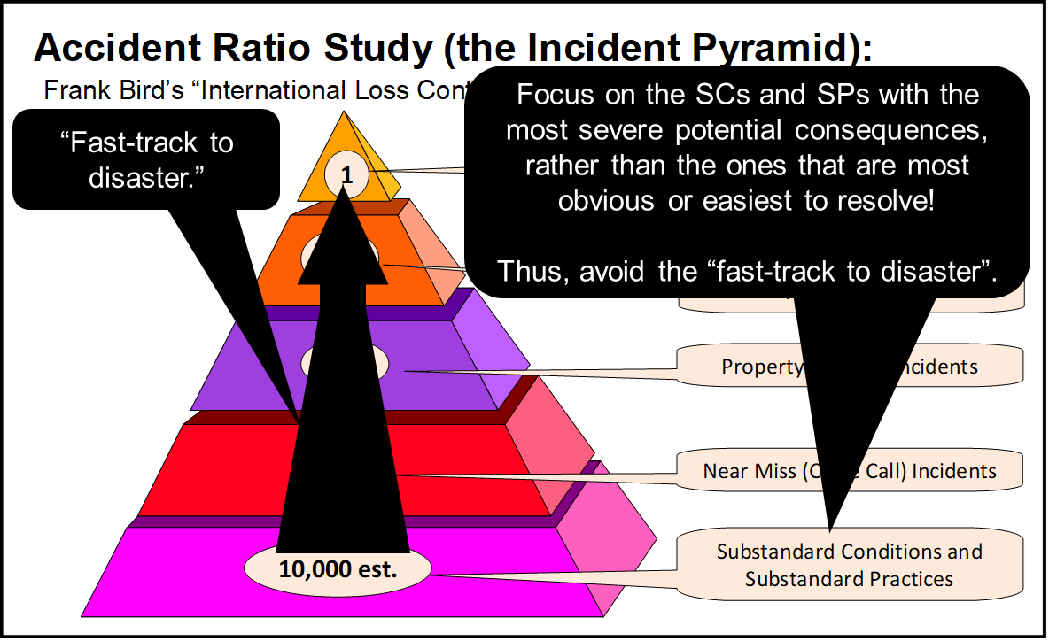
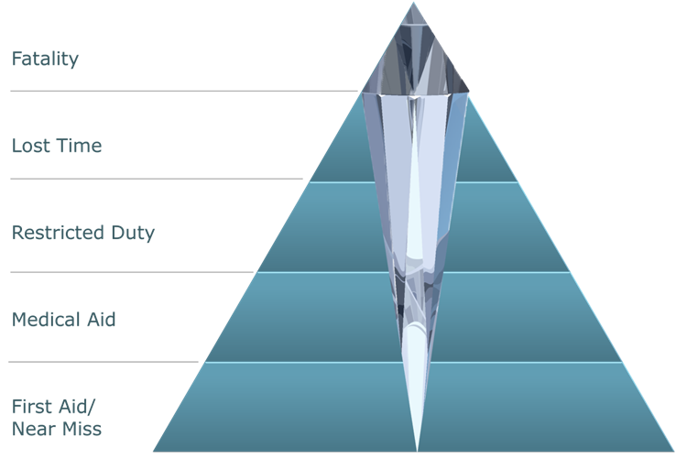
Management System Did Not Focus on Process Safety Risks:
“Mine the diamond!”
Leaders must allocate finite resources to make sure high-hazard operations (i.e. facilities and operations with significant process safety hazards) are sustainably managed to acceptable risk exposure levels.
We need to understand our major risks to focus
limited resources on the right areas (major hazards
and the HiPo incidents) – strategic thinking!
With a clear understanding of our major hazards,
we are better prepared to ask the right questions
to manage them.
Pay attention to the critical “leading indicators”
e.g. SC’s and SP’s relating to process safety
i.e. HiPo Incidents!
Anomalies that resolve themselves with no immediate
negative consequences are a signal that something
is wrong and needs to be investigated!
BP and TransOcean were certainly focused on
occupational safety, but what about process safety?
What signals were available?
Case 7: BP-Macondo DWH 2010
22
Notes:
22

Slide 23
RME #4: Management of Change:
Was the change – different spec’ns to seal the well – managed?
There were differences of opinion on how to seal the well …
  The Transocean Manager vs the BP Manager
  The BP Manager wanted … because it expedites the process.
  “Well, my process is different. I think we are going to do it this way.”
It became clear who was ultimately responsible and accountable.
This decision was made despite knowing the deficiencies in the Blowout Preventer (BOP).
The appropriate decision should have been to stop.
    “Stop. Think. Don’t do something stupid.”
    Professor Bob Bea
Case 7: BP-Macondo DWH 2010
23
Notes:
23

Slide 24
ALE #2: Examine RME #6: PECI
“In fact, post-incident CSB analyses of Transocean and BP risk management policies at the time of the blowout reveal that many of the policies would have satisfied current (legal) requirements.
Yet the companies did not effectively implement these policies to manage the major accident risks of the Macondo well, and the companies were not held accountable by the regulator to ensure that they managed safety as their company policies stipulated.”
Please confer and select the best response (MM-Poll):
What needed to change, much earlier in the operating life of BP-DWH, in order to prevent an incident? In other words, what could we do as leaders to push implementation? Hint: think PE&CI.
Case 7: BP-Macondo DWH 2010
24
Notes:
24
24
The answer here is to “implement those policies”. But of course, this is far easier said than done, so give some insight into why this is a very difficult undertaking to “implement policies”.

Slide 25
Examine RME #6: PECI
“In fact, post-incident CSB analyses of Transocean and BP risk management policies at the time of the blowout reveal that many of the policies would have satisfied current (legal) requirements.
Yet the companies did not effectively implement these policies to manage the major accident risks of the Macondo well, and the companies were not held accountable by the regulator to ensure that they managed safety as their company policies stipulated.”
Through Formal Audits, driven by a robust PE&CI program and committed leadership, senior leadership would have discovered that:
  Critical changes were being made without adequate, thorough reviews, and
  Process safety risks were not being managed to any great degree, certainly not as thorough as were the risks for occupational activities.
  Process safety issues (SC’s, SP’s, NM’s, and lower-impact LI’s) were not being investigated nor addressed.
Our management system will only be effective when it is developed,
implemented, and maintained through active program evaluation and
continuous improvement.
Q: What needed to change in order to prevent an incident?
“Implement those ESRM policies” - far easier said than done.
What could we do as leaders to push implementation?
Case 7: BP-Macondo DWH 2010
25
Notes:
25
25
The answer here is to “implement those policies”. But of course, this is far easier said than done, so give some insight into why this is a very difficult undertaking to “implement policies”.

Slide 26
Application of the Engineer’s Survival Guide:
The report stated that "whether purposeful or not, many of the decisions that BP, Halliburton, and Transocean made that increased the risk of the Macondo blowout clearly saved those companies significant time (and money).”
The Engineer’s Survival Guide:
Understand company values!
Understand your program!
When you make decisions, put safety ahead of any other objective!
Pay attention to failures in safety systems and take action!
An opportunity to apply the Engineer’s Survival Guide:
What was the situation?
What was the issue with that situation?
What Key Point was violated?
What would you have done in that situation?
What would have been the probable outcome had you done it?
Case 7: BP-Macondo DWH 2010
26
Notes:
26

Slide 27
Summary & Key Lessons:
Mine the Diamond!
Leaders must smartly allocate finite resources to ensure high-hazard operations (i.e. with significant process safety hazards) are sustainably managed to acceptable risk exposure levels.
  We need to understand our major risks to focus limited resources on the right areas (major hazards, HiPo Incidents) – strategic thinking!
  With a clear understanding of our major hazards, we are better prepared to ask the right questions to manage them.
  Anomalies that do resolve themselves with no immediate negative consequences are a signal.
Pay attention to the critical “leading indicators”
e.g. SC’s and SP’s relating to process safety!
Our management system will only be effective when it is developed,
implemented, and maintained through active program evaluation and continuous improvement.
Case 7: BP-Macondo DWH 2010
27
Notes:
27

Slide 28
Any questions?
Notes:
28

Slide 29
Complete Slide Deck follows with details.
29
Notes:
29

Slide 30
Fundamentals of RM
RM System and Process
Leadership in RM
Incident Investigation
RM Tools & Challenges
RM in Industry
People & Org.
Application and Perspectives
On Becoming a
Leader in Risk Management
ENGG404 - Lecture
Case 7: BP-Macondo
Oilfield and DeepWater Horizon Rig
(2010)

Slide 31
Learning Outcomes
Explain that management has the responsibility for sound risk management systems covering both occupational safety and process safety.
Demonstrate why leaders must smartly allocate finite resources to ensure high-hazard operations (i.e. with significant process safety hazards) are sustainably managed to acceptable risk exposure levels.
Evaluate a loss incident to identify the latent causes and associated management system improvement opportunities.
Case 7: BP-Macondo DWH 2010
31
Notes:
31

Slide 32
Background:
Deep Sub-sea Drilling:
low likelihood of something going wrong, but with extremely high consequence if it does
Three major corporations:
BP Energy: awarded the mineral rights to drill & produce
TransOcean: the rig owner (contracted by BP to drill the well)
Halliburton: well services (under contract to BP for mud & cement)
Case 7: BP-Macondo DWH 2010
32
Notes:
32

Slide 33
Background:
Deepest oil well in history - 35,000 ft (10,500 metres) – a Record!
There was a rush to get to production
  6 weeks normal versus 21 days target
  Previous well into the Macondo formation had to be abandoned
  because drilling was rushed.
The rig had operated for Seven (7) years without a Lost-Time Injury
  A great achievement!
  BP management were on the rig that day to give the crew a safety award.
The BOP had been damaged 4 weeks before the incident
  Workers were told it wasn’t important, it wasn’t fixed, and
  operations continued as though it was working properly
Unclear chain of command for changes made to activities
  Who was in charge? BP or TransOcean?
Case 7: BP-Macondo DWH 2010
33
Notes:
33

Slide 34
The Basics Of Well Control:
Surface to sea-floor BOP ~15 metres Drilling End ~ 3 metres
Case 7: BP-Macondo DWH 2010
34
Notes:
34
34
Much of this info is presented in the videos, so suggest that they listen for the details of the technology, especially for the engineers who do not study petroleum engineering. Briefly explain:
The distance between the rig and the sea-floor.
The depth beyond the sea-floor that the drill goes.
The purpose and basic design of drilling fluid (mud).
The basic theory of a “kick”.
The need to ensure that the drill bit speed does not exceed specified conditions (cracks the formation).
The purpose of cementing and location of plugs after drilling is complete and the well is being sealed in for future production.
The purpose of a BOP.

Slide 35
The Loss Incident & Impacts on PEAP
The Loss Incident:
Date: 20-April-2010 to 15-July-2010
Platform: Deepwater Horizon Drilling Rig
Location: The Macondo Prospect, Gulf of Mexico
Corporations: BP plc, TransOcean, Halliburton
Impact on PEAP:
P: 11 killed, 16 seriously injured
E: Inestimable impact
A: Tens of billions of dollars
P: Broad interruptions for US Gulf of Mexico offshore drilling industry; and Significant regulator intervention with regulatory impact
* Prolonged and extensive media coverage (reputational impact)
Case 7: BP-Macondo DWH 2010
35
Notes:
35
35
Much of this info is presented in the videos, so provide a very brief overview of the corporations involved and the Impacts on PEAP.

Slide 36
Documentary Videos – Viewed via eClass:
These Documentary Videos on the BP DWH Blowout, Gulf of Mexico, LA, are posted on eClass for viewing prior to the lecture.
US-CSB Video:
00:00-01:20 Introduction and CSB Investigation
01:21-02:35 Technical explanation – drilling, mud, kicks
02:36-03:38 BOP Operation
03:39-04:57 The Kick initiates the incident
04:58-05:24 Buckled Pipe and Effective Compression
CBS News 60 Minutes Video, Part 1:
02:03-03:04 Background
02:18-03:04 Technical explanation - rate of penetration
03:05-04:36 “Tension” – push to do things safely but fast (competing priorities)
CBS News 60 Minutes Video, Part 2:
02:40-7:15 Professor Bob Bea – discussion points akin to “The Engineer’s Survival Guide”
Case 7: BP-Macondo DWH 2010
36
Notes:
36

Slide 37
Incident Causes
Rush to “get the job done”:
  Drilling rate faster than specified for formation
  Cement barrier (plug) not effectively installed
  Premature removal of drilling fluid / mud before cement plugs were completed (cured)
Defective Blowout Preventer operation – a “safety-critical device”:
  Damaged Annular on the BOP
  Inoperative Control Pods on the BOP
  Damaged hydraulic line and weak battery on the BOP
Incorrect interpretation of well data:
  Inadequate standards or inadequate compliance with standards
  Process signals of a “kick” ignored (the lead-up prior to a blow-out)
  Cement integrity test did not give a clear “pass / fail” i.e. pressure test failed to confirm mud and plug integrity (pressure should have remained static / less mud returned to surface)
Case 7: BP-Macondo DWH 2010
37
Notes:
37

Slide 38
Incident Causes
Excerpt from The US-CSB Report:
“On the day of the April 20 tragedy, no effective safeguards were in place to eliminate or minimize the consequences of a process safety incident.
The safeguards (the physical barriers such as drilling mud, steel casing, cement plugs, “kick” detection, cement barrier testing, and BOP) intended to prevent such a disaster were not properly constructed, tested, or maintained, or they had been removed.
The management systems intended to ensure the required functionality, availability, and reliability of these safety-critical safeguards were inadequate.
Ultimately, the safeguards meant to prevent, mitigate, or control a blowout failed on the day of the accident.
If the drilling column fluid (mud weight) barrier and the cement barrier both fail, and the well is still open (no plug installed), drilling crews depend on a blowout preventer (BOP) to control pore pressures.”
US Chemical Safety And Hazard Investigation Board;
Investigation Report, Volume 1; Explosion And Fire At
The Macondo Well; Report No. 2010-10-I-OS; 5-June-2014
* Layers of Protection
Three LoP* failed!
Case 7: BP-Macondo DWH 2010
38
Notes:
38

Slide 39
Immediate and Basic Causes … Latent Causes? Culture?
Continue to Drill Down in the RCA:
The preceding pages provide sufficient content for any ENGG404 team of students to generate an RCA chart and drill down to latent causes.
But what would we find? Given the magnitude of this event, would we expect to find latent causes categorized as “P” or “S” or “C”?
US-CSB report:
“The management systems intended to ensure the required functionality, availability, and reliability of these safety-critical safeguards were inadequately implemented.”
“Ultimately, while BP and Transocean had rigourous corporate polices for risk management, neither company ensured their implementation at Macondo.”
“The major hazards of drilling associated with process safety (containment of hydrocarbons under pressure) lacked management oversight compared to occupational safety.”
Sounds like a “C” … but let’s read on! (Focus on the bold text phrases …)
Case 7: BP-Macondo DWH 2010
39
Notes:
39

Slide 40
Culture and Organizational Factors: (Focus on the bold text phrases …)
Excerpt from Letter to Tony Hayward, CEO, BP from U.S. House Committee on Energy and Commerce officials:
“BP appears to have made multiple decisions for economic reasons that increased the danger of a catastrophic well failure.
In several instances, these decisions appear to violate industry guidelines and were made despite warnings from BP’s own personnel and its contractors.
In effect, it appears that BP repeatedly chose risky procedures in order to reduce costs and save time, and made minimal efforts to contain the added risks.”
Waxman, Henry, Committee Chair, U.S. House Committee on Energy and Commerce, and Bart Stupak, Chair of Subcommittee on Oversight and Investigation, U.S. House Committee on Energy and Commerce. 2010. Letter to Tony Hayward, Chief Executive Officer, BP PLC. http://energycommerce.house.gov/documents/20100614/Hayward.BP.2010.6.14.pdf; accessed 10-June-2010
Freudenburg, William R., and Robert Gramling. 2011. “Blowout in the Gulf: The BP Oil Spill Disaster and the Future of Energy in America”; Cambridge, Massachusetts. The MIT Press; page 47
Case 7: BP-Macondo DWH 2010
40
Notes:
40

Slide 41
Culture and Organizational Factors: (Focus on the bold text phrases …)
Excerpt from Davis to Gramling, Personal Communication:
“My initial assessment of the MC252 (BP-Macondo) incident is failure by BP management to manage a series of technical and operational changes.
Failure to conduct a proper hazard analysis on the first change was a secondary change.
The MC252 loss incident is not an operator nor mechanic (i.e. technical) root cause but a corporate management root cause.”
Davis, J. Frank. 2010. Personal communication, email to Robert Gramling. 8-July-2010
Freudenburg, William R., and Robert Gramling. 2011. “Blowout in the Gulf: The BP Oil Spill Disaster and the Future of Energy in America”; Cambridge, Massachusetts. The MIT Press; page 161
Case 7: BP-Macondo DWH 2010
41
Notes:
41

Slide 42
Culture and Organizational Factors: (Focus on the bold text phrases …)
Excerpt from Kletz to Gramling, Personal Communication:
“There has been much discussion of the immediate technical causes of the 2010 BP oil leaks, but the underlying or root cause was a change in the culture of the company as a whole, particularly in the U.S. Back in the 1960s and 1970s, BP had a good safety record and safety culture. Why has it changed?
Every manager in the chemical and oil industries (and no doubt many others) knows that many operators, maintenance workers, foremen, and shift managers … will start taking short cuts or stop following instructions if they can get away with it. Their attitude is a macho one, there their job is to make product, not fill in forms such as a permit –to-work. Professional staff, at all levels, should check details frequently or the procedures will corrode faster than the steelwork and soon vanish without trace. It is not enough for the professional staff (leadership) to take a helicopter view.
On many, perhaps most, offshore rigs and platforms, the senior person in charge is usually someone who has risen form the ranks and would have been a foreman or shift manager if he had stayed onshore. While professional staff visit from time to time, there is no day-to-day checking (by someone at a higher level). When there is a problem, the attitude of the senior person on the rig or platform is often a macho one: “Forget the rules. Let’s get stuck in a finish the job.”
(Alberta parlance is “Git ‘er done!”)
It is easy to point the finger at the management and assume that a culture of cutting corners started at the top, and was motivated by money. It is worth remembering that the same culture can also originate at the bottom, driven by the desire to get the job done. The task of management is to know this and make sure it is done properly.”
Kletz, Trevor. 2010. Personal communication, email to Robert Gramling. 8-July-2010
Freudenburg, William R., and Robert Gramling. 2011. “Blowout in the Gulf: The BP Oil Spill Disaster and the Future of Energy in America”; Cambridge, Massachusetts. The MIT Press; page 161-162
Case 7: BP-Macondo DWH 2010
42
Notes:
42

Slide 43
Culture and Organizational Factors: (Focus on the bold text phrases …)
Excerpt from Journal of Drilling Engineering:
“The majority of organizational factors are associated with conflicting incentives that are provided to the drilling and workover personnel.
These conflicting incentives most often are those of production and safety.
These conflicting incentives are not unique to drilling and workover operations in this industry or even to the oil and gas industry.”
Bea, R.G. 1998. “Real-time Prevention of Drilling and Workover Blowouts: Management Rapidly Developing Crises.” Journal of Drilling Engineering, May:1-10.
Freudenburg, William R., and Robert Gramling. 2011. “Blowout in the Gulf: The BP Oil Spill Disaster and the Future of Energy in America”; Cambridge, Massachusetts. The MIT Press; page 162
Case 7: BP-Macondo DWH 2010
43
Notes:
43

Slide 44
Culture and Organizational Factors:
Key Cultural Issues on Macondo:
Competing objectives (conflicting incentives) of costs, schedule, and production over safety!
“BP made multiple decisions for economic reasons that increased the danger of a catastrophic well failure … BP repeatedly chose risky procedures in order to reduce costs and save time”
Normalization of Deviance (Atrophy of Compliance):
“Workers will start taking short cuts or stop following instructions if they can get away with it …”
“It is easy to point the finger at the management and assume that a culture of cutting corners started at the top, and was motivated by money. It is worth remembering that the same culture can also originate at the bottom, driven by the desire to get the job done.”
“The task of management is to know this and make sure it is done properly.” Kletz, 2010.
Case 7: BP-Macondo DWH 2010
44
Notes:
44

Slide 45
Culture and Organizational Factors:
More Cultural Issues about on Macondo:
Incident happened after drilling & cement job completed, and nearing well-completion!
Transocean had a similar rig incident which demonstrated the need for well monitoring (lower consequences) in the UK just four months prior, but no transfer of lessons to Gulf of Mexico.
The major hazards of drilling associated with process safety (containment of hydrocarbons under pressure) lacked management oversight compared to occupational safety.
BP experienced a significant process safety-related loss at their Texas City refinery in 2005 but a shift of the risk paradigm to focus more on process safety was lacking in the BP drilling organization in 2010.
Key Lesson: It takes time to change culture!
Case 7: BP-Macondo DWH 2010
45
Notes:
45

Slide 46
ALE #1: Identify Weaknesses in the RMS
Please confer (pen-to-paper, MM vote on your top 3)!
Take a moment to think about this question:
Besides the obvious weakness in the first element (Management Leadership, Commitment and Accountability), what other elements of the risk management system were weak?
Risk Management System (APEGA Model):
Management Leadership, Commitment and Accountability.
Risk Assessment and Management of Risks.
Community Awareness and Emergency Preparedness.
Management of Change.
Incident Reporting, Investigation, Analysis and Actions.
Program Evaluation and Continuous Improvement.
Design, Construction and Start-up.
Operations and Maintenance.
Employee Competency and Training.
Contractor Competency and Integration.
Operations and Facilities Information and Documentation.
Case 7: BP-Macondo DWH 2010
46
Notes:
46

Slide 47
RME #1 Management Commitment, Leadership & Accountability
The report stated that "whether purposeful or not, many of the decisions that BP, Halliburton, and Transocean made that increased the risk of the Macondo blowout clearly saved those companies significant time (and money).”
Q: What was the priority of management?
In the weeks and days leading up to the loss incident, the priority was getting the well to completion (drilled to depth, and capped) in order to save time and money.
Certainly, there was a priority and focus on occupational safety.
But there was minimal focus on process safety.
Q: What was the evidence for this lack of focus on process safety?
Rushing to complete the drilling work (over budget, behind schedule, focus on costs).
Disregard for critical safety engineered systems for controlling down-hole pressures, detection of leakage, and blow-out prevention.
Case 7: BP-Macondo DWH 2010
47
Notes:
47
47
Details directly from the CBS video and also in their course ware.

Slide 48
RME #1 Management Commitment, Leadership & Accountability
The report stated that "whether purposeful or not, many of the decisions that BP, Halliburton, and Transocean made that increased the risk of the Macondo blowout clearly saved those companies significant time (and money).”
Q: What was the priority of management?
In the weeks and days leading up to the loss incident, the priority was getting the well to completion (drilled to depth, and capped) in order to save time and money.
Certainly, there was a priority and focus on occupational safety.
But there was minimal focus on process safety.
Q: What was the evidence for this lack of focus on process safety?
Rushing to complete the drilling work (over budget, behind schedule, focus on costs).
Disregard for critical safety engineered systems for controlling down-hole pressures, detection of leakage, and blow-out prevention.
Case 7: BP-Macondo DWH 2010
48
Notes:
48
48
Details directly from the CBS video and also in their course ware.

Slide 49
RME #2: Risk Assessment & Management of Risk
No effective safeguards were in place to eliminate the likelihood of or minimize the consequences of a blow-out, a process safety incident.
The safeguards (the mud, steel casing, cement plugs, “kick” detection, cement barrier testing, and BOP) intended to prevent such a disaster were not properly constructed, tested, or maintained, or they had been removed.
The management systems intended to ensure the required functionality, availability, and reliability of these safety-critical safeguards were inadequate.
Ultimately, the safeguards meant to prevent, mitigate, or control a blowout failed on the day of the incident.
Case 7: BP-Macondo DWH 2010
49
Notes:
49

Slide 50
RME #2: Risk Assessment & Management of Risk
Recall that BP, Transocean, and all other contractor / service companies recognized Seven Years without an LTI!
  A remarkable achievement, yet there was a catastrophic incident with tragic losses.
The focus (measurement, recognition, reward) was on occupational safety, and much less on process safety.
What gets measured gets managed!
  Too often, the means to motivate managers is misdirected with well-meaning goals and targets, but the down-side:
  what is NOT measured is NOT well-managed!
Process safety risks associated with the drilling operations & well status were not appropriately considered, evaluated, or managed.
  When the pressure was on, process safety management lacked visibility and leadership attention.
Case 7: BP-Macondo DWH 2010
50
Notes:
50

Slide 51
Management System Did Not Focus on Process Safety Risks:
“Mine the diamond!”
Leaders must allocate finite resources to make sure high-hazard operations (i.e. facilities and operations with significant process safety hazards) are sustainably managed to acceptable risk exposure levels.
We need to understand our major risks to focus
limited resources on the right areas (major hazards
and the HiPo incidents) – strategic thinking!
With a clear understanding of our major hazards,
we are better prepared to ask the right questions
to manage them.
Pay attention to the critical “leading indicators”
e.g. SC’s and SP’s relating to process safety
i.e. HiPo Incidents!
Anomalies that resolve themselves with no immediate
negative consequences are a signal that something
is wrong and needs to be investigated!
BP and TransOcean were certainly focused on
occupational safety, but what about process safety?
What signals were available?
Case 7: BP-Macondo DWH 2010
51
Notes:
51

Slide 52
RME #4: Management of Change:
Was the change – different spec’ns to seal the well – managed?
There were differences of opinion on how to seal the well …
  The Transocean Manager vs the BP Manager
  The BP Manager wanted … because it expedites the process.
  “Well, my process is different. I think we are going to do it this way.”
It became clear who was ultimately responsible and accountable.
This decision was made despite knowing the deficiencies in the Blowout Preventer (BOP).
The appropriate decision should have been to stop.
    “Stop. Think. Don’t do something stupid.”
    Professor Bob Bea
Case 7: BP-Macondo DWH 2010
52
Notes:
52

Slide 53
ALE #2: Examine RME #6: PECI
“In fact, post-incident CSB analyses of Transocean and BP risk management policies at the time of the blowout reveal that many of the policies would have satisfied current (legal) requirements.
Yet the companies did not effectively implement these policies to manage the major accident risks of the Macondo well, and the companies were not held accountable by the regulator to ensure that they managed safety as their company policies stipulated.”
Please confer and select the best response (MM-Poll):
What needed to change, much earlier in the operating life of BP-DWH, in order to prevent an incident? In other words, what could we do as leaders to push implementation? Hint: think PE&CI.
Case 7: BP-Macondo DWH 2010
53
Notes:
53
53
The answer here is to “implement those policies”. But of course, this is far easier said than done, so give some insight into why this is a very difficult undertaking to “implement policies”.

Slide 54
Examine RME #6: PECI
“In fact, post-incident CSB analyses of Transocean and BP risk management policies at the time of the blowout reveal that many of the policies would have satisfied current (legal) requirements.
Yet the companies did not effectively implement these policies to manage the major accident risks of the Macondo well, and the companies were not held accountable by the regulator to ensure that they managed safety as their company policies stipulated.”
Through Formal Audits, driven by a robust PE&CI program and committed leadership, senior leadership would have discovered that:
  Critical changes were being made without adequate, thorough reviews, and
  Process safety risks were not being managed to any great degree, certainly not as thorough as were the risks for occupational activities.
  Process safety issues (SC’s, SP’s, NM’s, and lower-impact LI’s) were not being investigated nor addressed.
Our management system will only be effective when it is developed,
implemented, and maintained through active program evaluation and
continuous improvement.
Q: What needed to change in order to prevent an incident?
“Implement those ESRM policies” - far easier said than done.
What could we do as leaders to push implementation?
Case 7: BP-Macondo DWH 2010
54
Notes:
54
54
The answer here is to “implement those policies”. But of course, this is far easier said than done, so give some insight into why this is a very difficult undertaking to “implement policies”.

Slide 55
Application of the Engineer’s Survival Guide:
The report stated that "whether purposeful or not, many of the decisions that BP, Halliburton, and Transocean made that increased the risk of the Macondo blowout clearly saved those companies significant time (and money).”
The Engineer’s Survival Guide:
Understand company values!
Understand your program!
When you make decisions, put safety ahead of any other objective!
Pay attention to failures in safety systems and take action!
An opportunity to apply the Engineer’s Survival Guide:
What was the situation?
What was the issue with that situation?
What Key Point was violated?
What would you have done in that situation?
What would have been the probable outcome had you done it?
Case 7: BP-Macondo DWH 2010
55
Notes:
55

Slide 56
Summary & Key Lessons:
Mine the Diamond!
Leaders must smartly allocate finite resources to ensure high-hazard operations (i.e. with significant process safety hazards) are sustainably managed to acceptable risk exposure levels.
  We need to understand our major risks to focus limited resources on the right areas (major hazards, HiPo Incidents) – strategic thinking!
  With a clear understanding of our major hazards, we are better prepared to ask the right questions to manage them.
  Anomalies that do resolve themselves with no immediate negative consequences are a signal.
Pay attention to the critical “leading indicators”
e.g. SC’s and SP’s relating to process safety!
Our management system will only be effective when it is developed,
implemented, and maintained through active program evaluation and continuous improvement.
Case 7: BP-Macondo DWH 2010
56
Notes:
56

